Slide 1
5° e-commerce players annual meeting 第五届电子商务与物流企业家年会
The smart logistic center
智能物流中心
How FIVES can contribute to the development of e-commerce logistics in China
法孚可以为中国的电子商务发展做些什么
Beijing
19° November 2015

Slide 2
The smart logistic center 智能物流中心
The CHALLENGE:
面临的挑战：
Increasing urbanization (Cities are growing!) 城市化进程加快（城市在发展!)
Increasing volumes of on-line purchases
日益增长的在线购物交易量
Increasing service levels expected: shorter time between order and delivery
日益增长的服务水平需求：从下单到送达的时间越来越短

Slide 3
The smart logistic center智能物流中心
The impacts on the LOGISTIC CENTER:
对物流处理中心的影响：
More orders/shipments to be handled in less space – space will be more expensive and difficult to obtain in crowded cities
有限空间内需要处理越来越多的订单/出货- 场地成本升高，在大城市很难获取足够空间
The performances will be pushed to higher values: more throughput, more accuracy, less tolerance to interruptions
对系统处理能力要求越来越高：更高的处理量，处理更精确，系统干预越来越少
In the highly density populated areas the “zero emission” will become a must
对于人口密集地区，必须做到“零排放”

Slide 4
The smart logistic center智能物流中心
What is FIVES OFFER to respond to these needs?
对于上述需求，法孚能够做些什么呢？
The most advanced technological solutions based on state of the art own products – in particular the GENI-belt cross belt sorter
基于自主研发的最先进的技术方案- 特别是交叉带分拣机GENI-belt
Ultimate performances, designed, proven and tested in several severe applications worldwide.
最优处理能力，在全球范围内的多个应用行业得到了验证。
A solid tradition in sustainable innovation, recently confirmed by the ENGINEERED SUSTAINABILITY recognition given to the GENI-belt
一贯保持持续创新方针，最近GENI-belt获得了ENGINEERED SUSTAINABILITY 认证。
The attitude and the capacity to listen and to develop solutions as a real business partner
作为一个真正的商业合作伙伴，倾听客户的声音，有能力为客户提供研发解决方案。

Slide 5
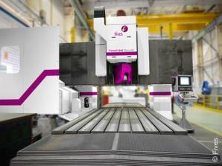
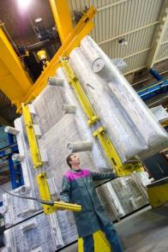
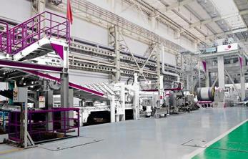
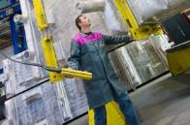
Fives, an international industrial engineering Group 法孚，是一个国际化的工业工程集团
Fives designs and supplies machines, process equipment and production lines for the world’s biggest industrial players.
法孚专注于为世界最大工业行业提供工艺设备，生产线以及工程设施的设计与供货。

Slide 6
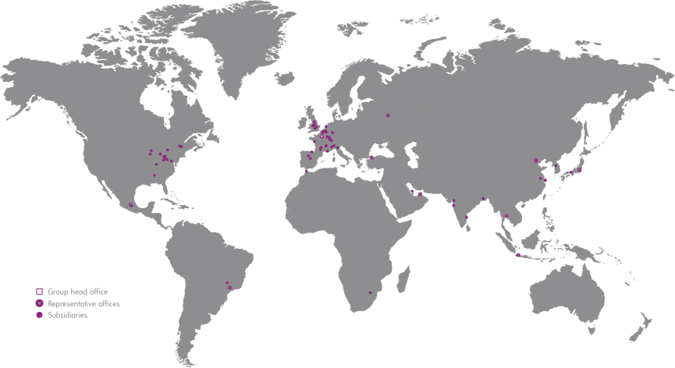
An international organization based on a worldwide network of subsidiaries
法孚是一个国家化集团组织，子公司遍布全球。
€1,626 million
百万
90
of sales
销售额
_{about}
subsidiaires and commercial offices in about 30 countries
分部和办公室，遍布30多个国家
_{8,000}
_{Close to}
_{约}
_{Employees员工}

Slide 7
Fives is organized around teams of dedicated experts 法孚在各个领域都有自己的专家团队
Steel
Sugar | Bioenergy
Chemtec
Aluminium
Metal Cutting | Composites
Combustion
Piping Solutions
Automation
Manufacturing
Filling | Sealing
Maintenance
Cutting Tools I Abrasives
Intralogistics
Grinding | Ultra Precision
Cement | Minerals
Cryogenics | Energy
Induction
Glass

Slide 8
Intralogistics solutions Intralogistics的物流方案

Slide 9
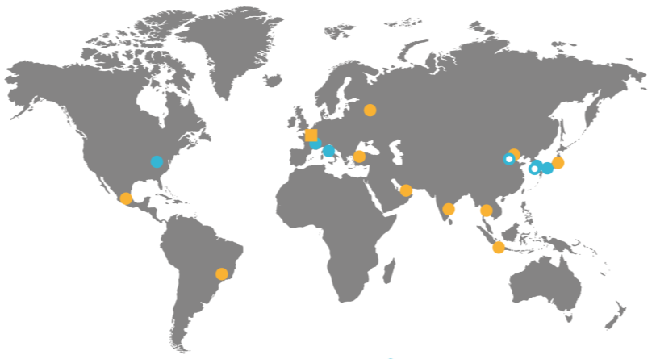
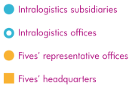
Innovating for optimizing solutions 最新科技 最优方案
70年
years of experience in intralogistics 在物流行业的经验
10 million百万
parcels delivered every day 每天分拣的包裹量
More than 超过
2,000
Installationsworldwide全球项目施工案例

Slide 10
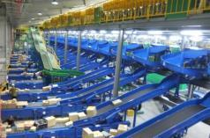
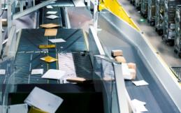
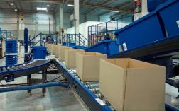
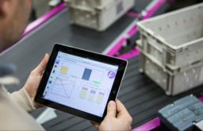
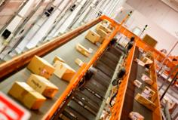
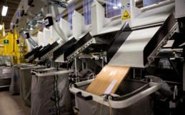
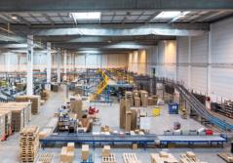
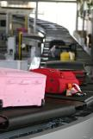
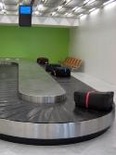
Innovative solutions for the material handling sector 物料处理行业的方案革新
Sortation 分拣 | Singulation 分离系统 | Order fulfillment 订单分拣 | WCS
Courier 快递 | Postal 邮政 | Distribution 配送中心 | Airport 机场

Slide 11
Six decades of breakthrough technology
数十年来法孚在技术上的突破：
1975 ̶ The first shoe sorter 第一台滑块分拣机
1982 ̶ The first cross-belt sorter.第一台交叉带分拣机
1989 ̶ The first singulator第一个批量物品分离系统（平面）
_ The first Linear Parcel Singulator
第一台直线式批量物品分离系统
_ The first low voltage fully electric conveyor
第一台低压全电动输送机
_The first single pass mega hub
第一个单次处理订单过百万的分拣应用 (more than 20,000 pph) (超过20,000 件/小时)
_ The first ACCORD singulator
第一个批量物品分离系统（立体三维）
2009 ̶ The first slide sorter for automatic sortation of irregulars 第一台处理不规则物品的滑行式分拣机
2012 ̶ The first SDX 第一台SDX
_ Launch of Trace® 3.0, Fives’ WCS
启动追踪系统® 3.0, Fives’ WCS

Slide 12
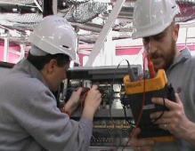
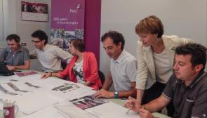
A complete range of services 服务范围广
Experts technicians专家团队
specialized in automated logistics solutions
致力于研发自动化物流解决方案
OPERATION
运营
OPTIMIZATION
优化
EVOLUTION
升级
24/7 Hot line and on site support
Operational rump up support
7天24小时热线和驻场支持服务
Data analysis and consulting
Global service “on performance”
Training and audits
数据分析和绩效考核
System and business evolution
Upgrades
Customer’s club
系统和业务升级

Slide 13
Build your customized solution with Fives 法孚根据客户要求量身定制解决方案
Listening 倾听客户的声音 | + State-of the art technology 尖端技术 | + Innovative culture 创新文化 | = Ultimate solutions 最优方案

Slide 14
Innovation success – solutions “out of the box” 创新取胜-“别出一格”的方案

Slide 15
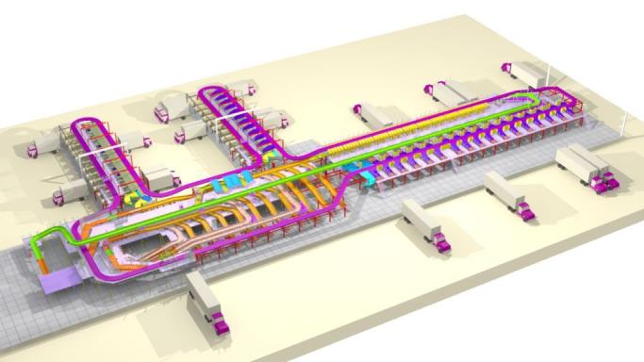
Chronopost
Express Courrier 快递运输
Customer: Chronopost – Lyon, France 客户：Chronopost-法国 里昂
Type of sorter 分拣机型号 | SBIR MD-W
Object type 处理物品种类 | Parcels and flyers 包裹和小件
Date of completion 竣工日期 | 2013
System capacity 系统处理能力 | 10.000 pph
N° of destinations 格口数量 | 133
Two additional sorting systems put in operation in 2014 in Arras and Chilly Mazarin (France) 2014年在法国的Arras和Chilly Mazarin ，法孚又新供货了2套分拣系统

Slide 16
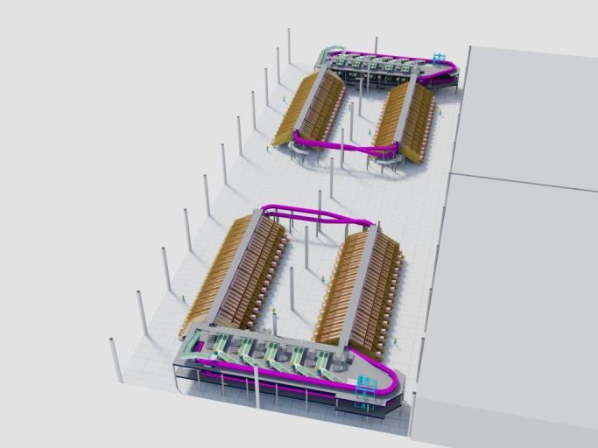
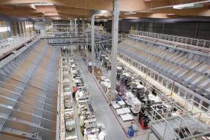
Dispeo – 3 Suisses (Otto Group)
Order fulfilment for e-commerce 电商行业的订单分拣
Customer: 3 Suisses (Otto Group) 客户：3 Suisses (Otto Group)
Type of sorter 分拣机型号 | n°2 SBIR SD 2台交叉带分拣机 SBIR SD
Object type 处理物品种类 | Flat textile items + boxes 平装纺织品+盒子
Date of completion 竣工日期 | 2013
System capacity 系统处理能力 | 26.000 pph
Sorter development 分拣机长度 | 2 x 295 m
N° of destinations 格口数量 | 1.036

Slide 17
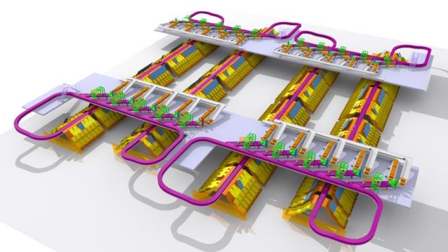
Mango
Order Fulfilment for garments 服装行业订单分拣
Customer: MANGO – Spain 客户：MANGO - 西班牙
Type of sorter 分拣机型号 | n°2 SBIR SD + n°1 SBIR MD
Object type 处理物品种类 | Textiles 纺织品
Date of completion 竣工日期 | In progress 项目执行中
Max. System capacity 最大系统处理能力 | 27.000 + 6.500 pph
Total sorters development 分拣机总长度 | 675 m
N° of destinations 格口数量 | 450

Slide 18
Technologies and Solutions 技术和解决方案

Slide 19
Our Products and Solutions 我们的产品和方案
Video of Chronopost Corbas
Video of Arsta
Remark – embed both in slide with simultaneous start side by side

Slide 20
70 years of successes 70多年的成就

Slide 21
Major customers in Distribution 配送市场主要客户

Slide 22
Major customers in Courier 快递行业主要客户

Slide 23
Major customers in Postal 邮政行业主要客户

